Slide 1
From Victimization to Empowerment: Using Communal Narration to Address Military Sexual Trauma
Alisha Ali, PhD
New York University
Stephan Wolfert, MFA, Army Veteran
DE-CRUIT Veterans Program
Bruce D. Homer, PhD
City University of New York

Slide 2
Trauma and Mental Health in Military Veterans
The mental health needs of military veterans are currently underserved:
Veterans are at increased risk of addiction, homelessness, poverty, and other experiences related to mental health problems
The number of veteran suicides is greater than 22 per day
It is estimated that up to 70% of women veterans have experienced military sexual assault (often “rape by rank”)
We need mental health care that supports veterans’ reintegration back into civilian life

Slide 3
The DE-CRUIT Veterans Program
This program uses the concept of unit cohesion to reflect military culture and build community
The program uses cognitive processing and narration through theatre – specifically Shakespeare
Based on the first-hand experience of army veteran Stephan Wolfert
Veteran-informed practice: developed and delivered by veterans and for veterans

Slide 4
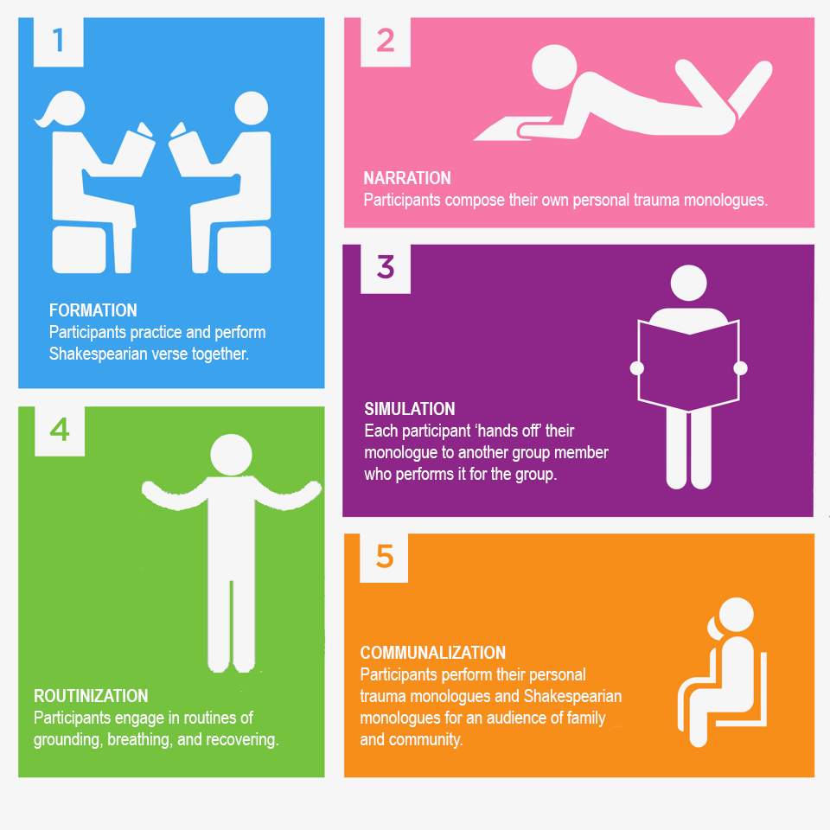

Slide 5
Women Veterans’ Trauma Monologues: Themes
For the women veterans who have taken part in our study, their primary trauma was not the typical expected forms of military trauma
Pattern of recurring trauma:
childhood abuse
enlisting to escape abuse
military sexual trauma

Slide 6
Supporting Women Veterans
Communalization is a key therapeutic element:
the audience witnesses their suffering
fellow veterans share in their pain
Next steps:
longer follow-up data collection
women-only DE-CRUIT sessions
expanding the DE-CRUIT program nationally

